Slide 1

Forecasting Demand Bike Sharing in San Francisco
Varnith Chordia
Akash Barnwal

Slide 2
Overview
What is Bike Sharing?
Motivation
Problem Statement- Data
Exploratory Data Analysis
Machine Learning techniques
Results
Station level prediction-Time Series
Shiny App

Slide 3




A brief idea about bikes..
Mobikers in China have travelled more than 2.5 billion km
This equates too:
This equal to going to the moon and back 3,300 times.
Reducing carbon emission by 540,000 tons
Taking 170,000 cars off the road for one year
Planting 30 million trees
PM
2.5
Eliminating 4.5 billion PM2.5 particles
Notes:
Insert Source
Advanta

Slide 4

What is Bike Sharing?

Slide 5
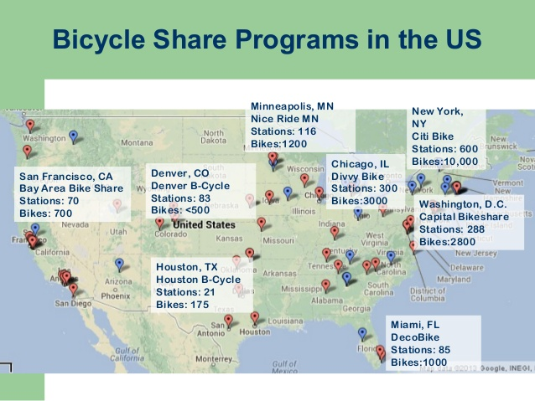
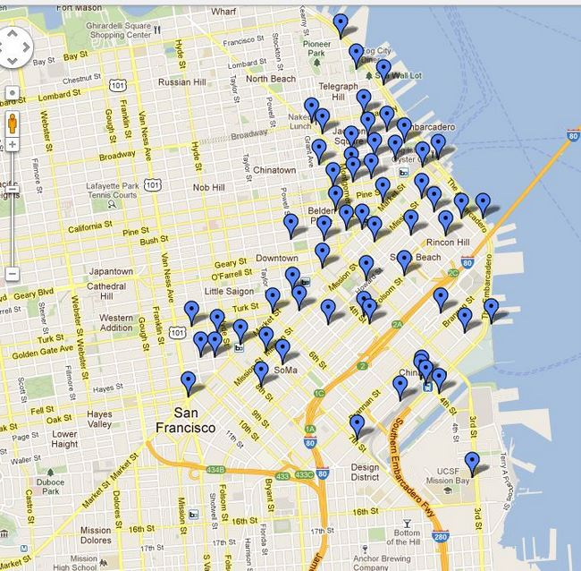
Bike sharing across US

Slide 6
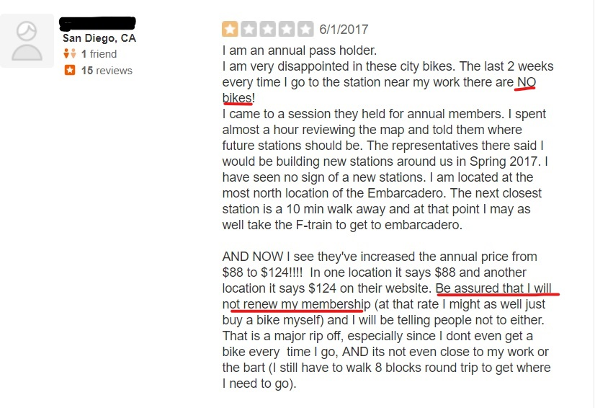
Challenges
Imbalance of Bikes - Shortage of bikes at a station. Due to high demand in certain stations, there is a lack of bikes available causing inconvenience.
Overflow - Low demand gives rise to more bikes available, hence shortage of parking or docking spots.
Notes:
Challenges the system face

Slide 7
Problem Statement
Demand prediction at Station Level
End Station Prediction
Bike demand forecasting
Demand prediction at City Level
Notes:
Graph

Slide 8
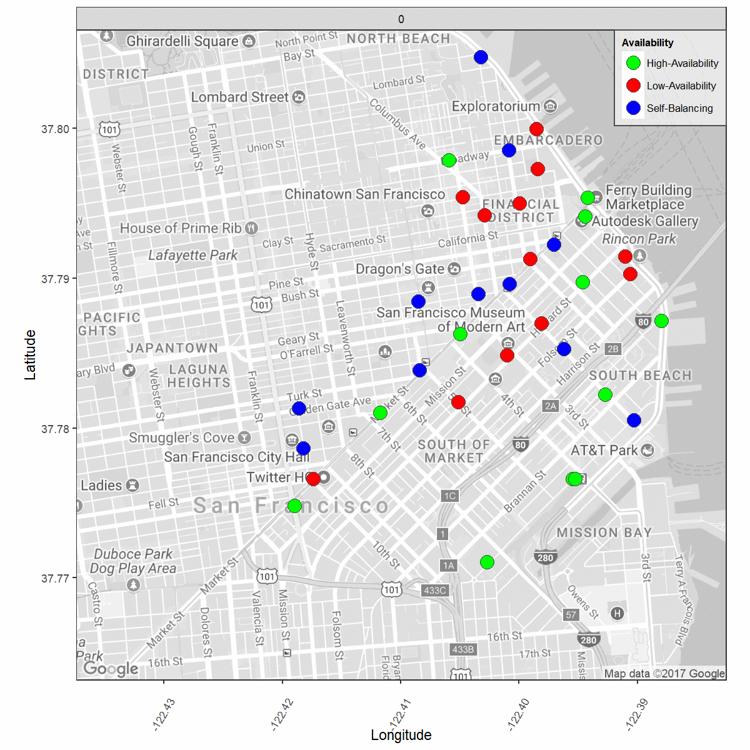
What is happening?
Applied K-Means clustering on bike availability data at every hour across all stations.
Clusters formed on stations were based on availability-High, Self, Low balanced stations.

Slide 9
Methodology
Cleaning and data transformation
Scraping and gathering data
Building Various ML models
Predicting on the future
Exploratory Data Analysis
Feature Engineering

Slide 10
Dataset Available
Trip Data aggregated at hourly level from August-2014 to August-2016
Features
Start Date
Hour
Counter
Temperature
Dew Point
Humidity
Pressure
Visibility
Wind Direction
Conditions
Year
Month
Final Data Set
Hourly data scraped
from wunderground

Slide 11
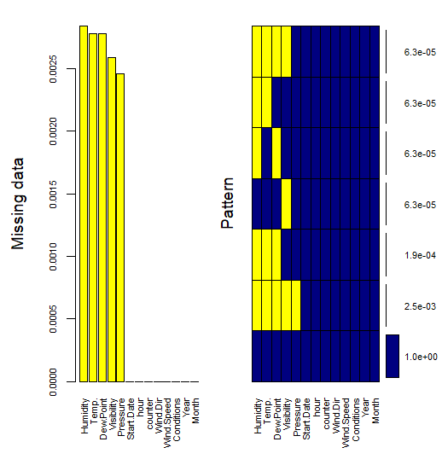
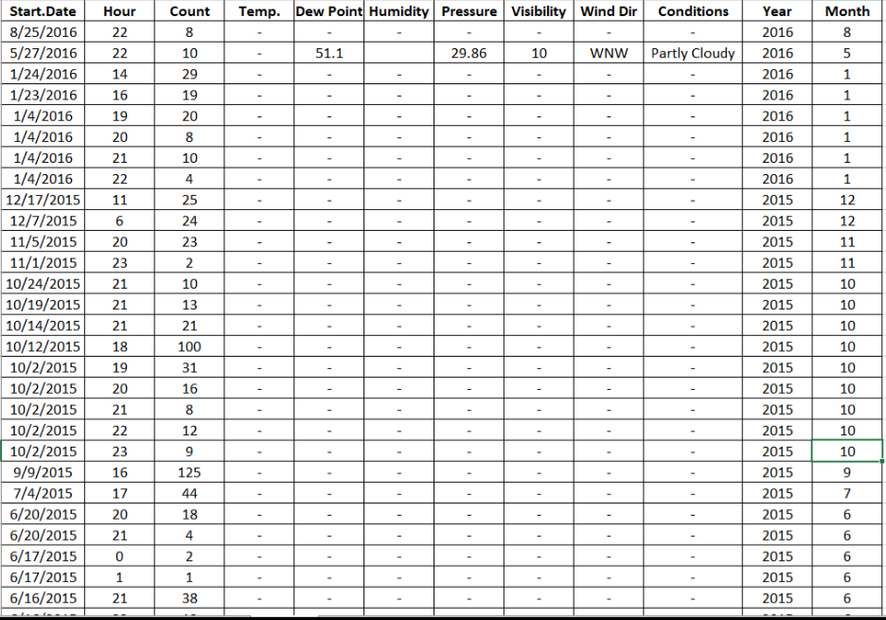
Missing Value Treatment
Due to lack of availability of weather information, there were missing values present.
Missing value present was no more than ~.02 %. So the observations were removed.

Slide 12
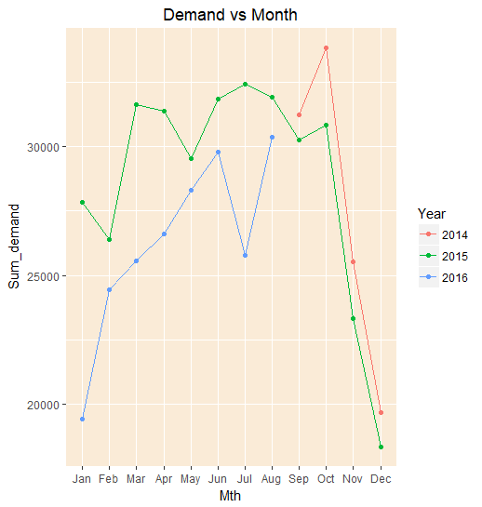
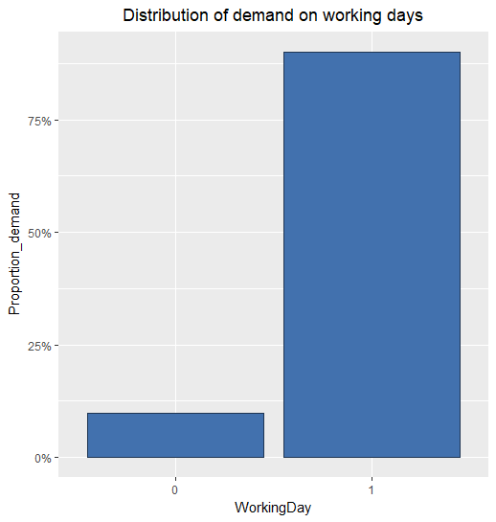
Exploratory Data Analysis(Contd.)
Demand over winter falls tremendously and it increases during the spring and summer.
Close to 90% of bike rides happened on working days.

Slide 13
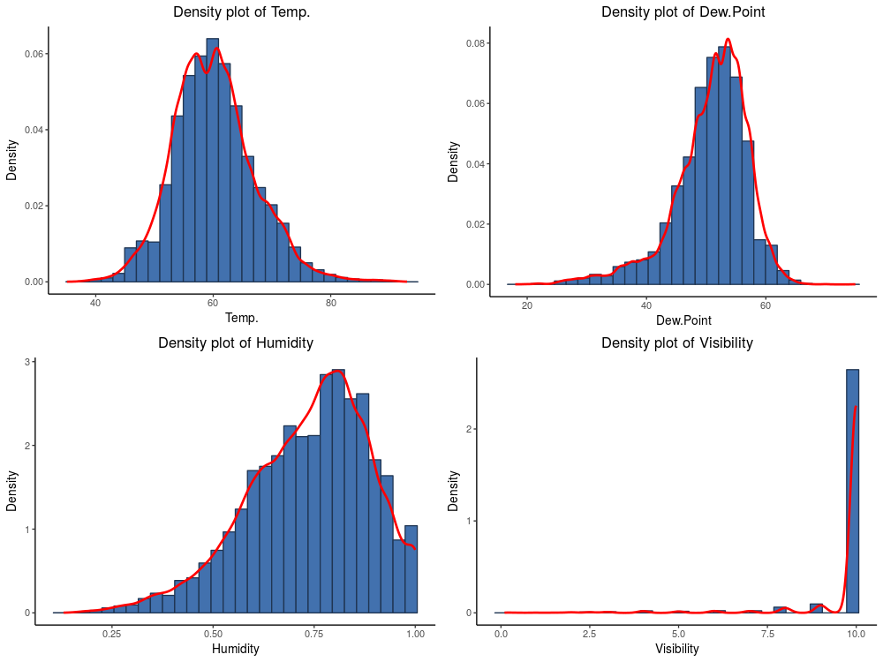
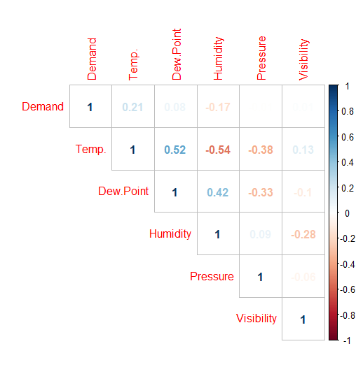
Exploratory Data Analysis(Contd.)
Poor correlation exists between demand and weather variables. These variables have non-linear interaction.
Univariate statistics of weather variables show important trends.

Slide 14
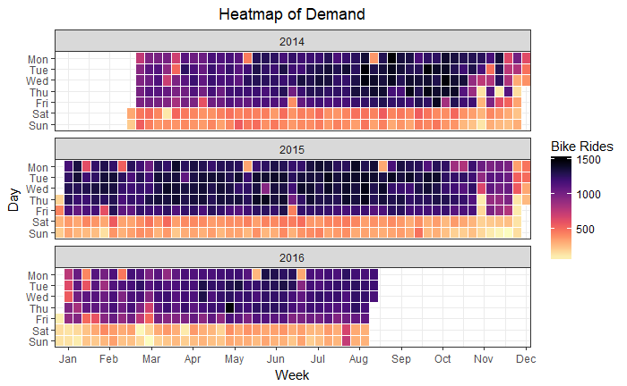
Exploratory Data Analysis(Contd.)
Most rides happened on weekdays and during months of Jul-Sep.
Certain weekdays had low bike rides, because of holidays.

Slide 15
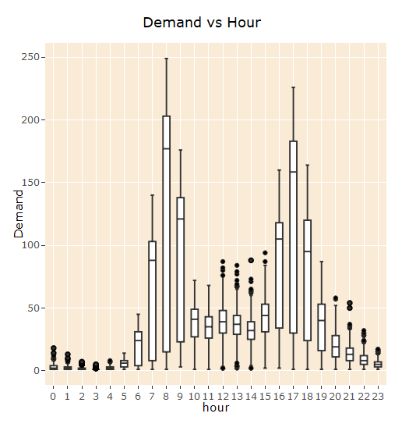
Exploratory Data Analysis (Contd.)
Box plot shows that early morning and late evening saw a greater demand.
Hours ‘7-9’ and ‘16-18’ are when maximum bike rides occurred.
These were mostly during office going hours and departing office hours.
Notes:
Change to plotly

Slide 16
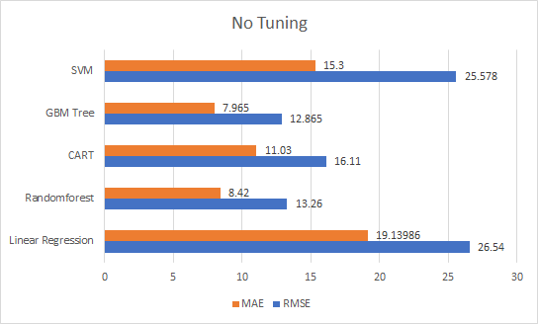
Results
Since the response is a continuous variable, we use advanced regression techniques to model our data.
Linear regression was used as the base model. It did not provide great results.
Modeling technique | RMSE | MAE
Linear Regression | 26.54 | 19.13
Regression trees | 16.11 | 11.03
SVR | 25.57 | 15.3
Random Forest Regression | 13.26 | 8.42
GBM | 12.86 | 15.3

Slide 17
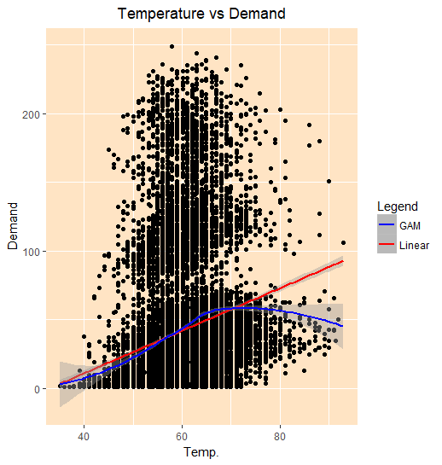
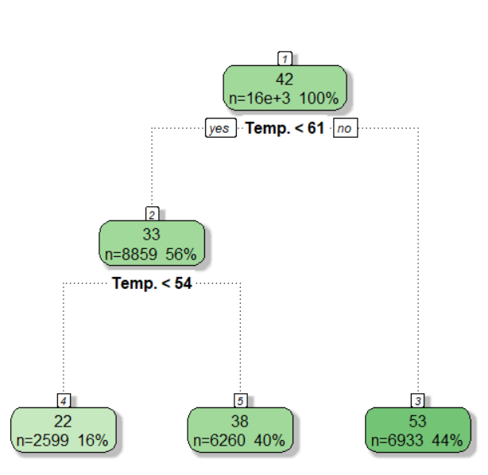
Feature Engineering
Temperature showed non-linear interaction with demand. Segmentation using decision tree was used to overcome this to help improve linear fit.
Another important variable added was peak hour. Rush hours/office hours were considered to be when there was most demand.
Features like working day, day of the week were other important variables added.

Slide 18
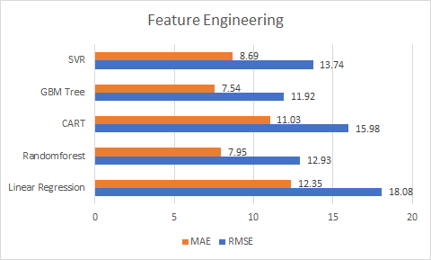
Results-Part2
Feature engineering improves the accuracy of the model significantly.
This accuracy can be made better with tuning.
Modeling technique | RMSE | MAE
Linear Regression | 18.08 | 12.35
CART | 15.98 | 11.03
SVR | 13.74 | 8.69
Random Forest | 12.93 | 7.95
GBM | 11.92 | 7.54

Slide 19
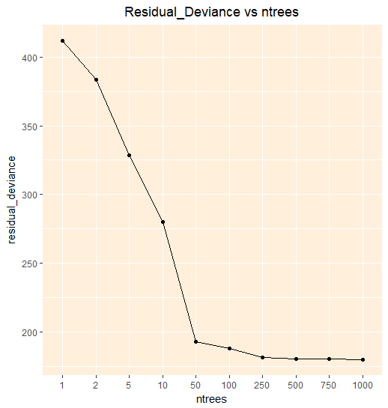
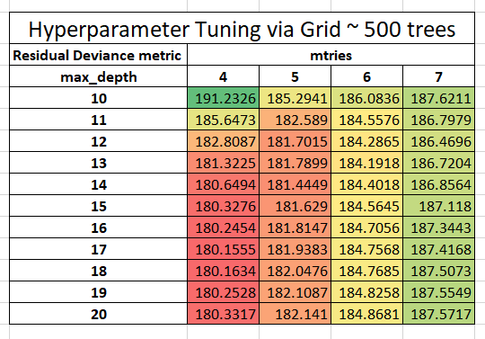
Parameter Tuning- Random Forest
The parameters to be tuned are trees, mtries and max depth. Increasing the number of trees, decreases variance but comes at a computation cost.
To decrease bias, depth of the tree is increased but this comes at increased variance.

Slide 20
Results- Part3
Modeling technique | RMSE | MAE
Linear Regression
CART
SVR
Random Forest
GBM

Slide 21
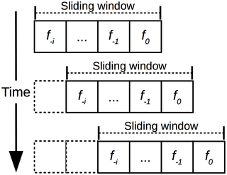
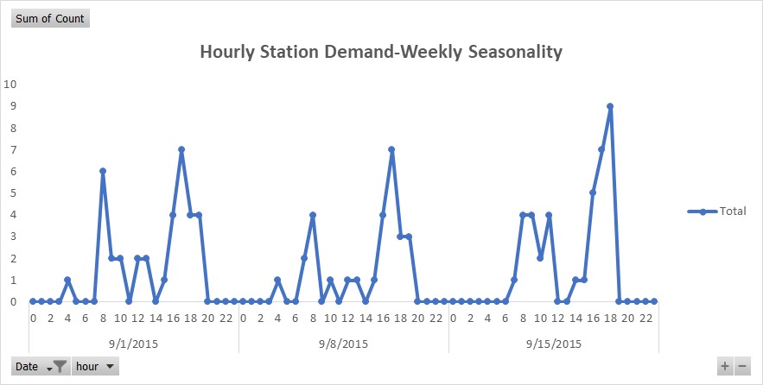
Station Level Prediction-Time Series
Seasonality of a week was observed and sliding window technique was used to create lagged values as predictors.
A lag of a month was used to create four different predictors.
Random forest regressors were used to model at each station.

Slide 22
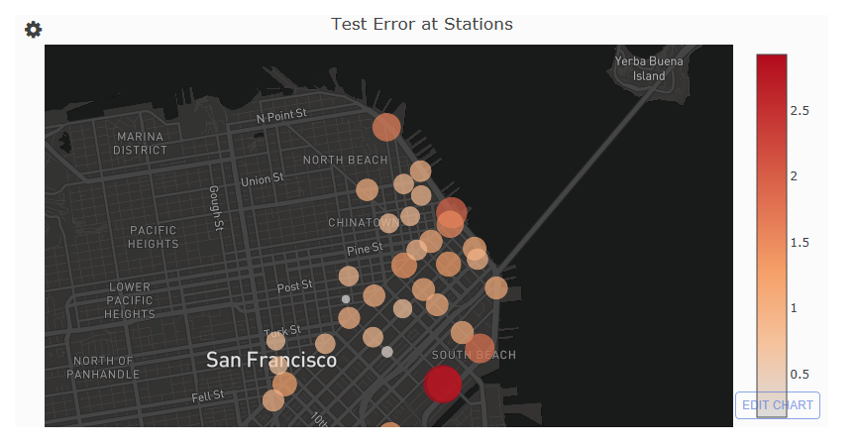
Results
Each bubble on the map is a station
Larger the bubble -Greater the error
Darker the bubble -
Greater the error

Slide 23
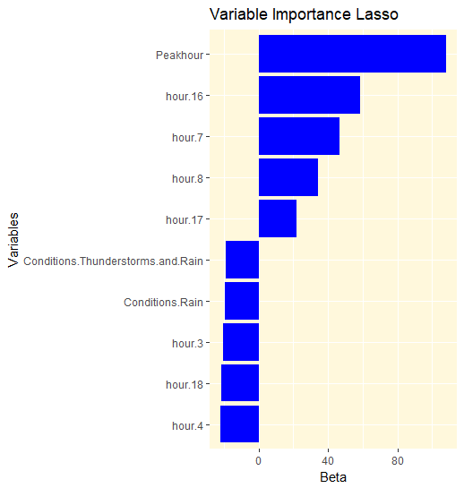
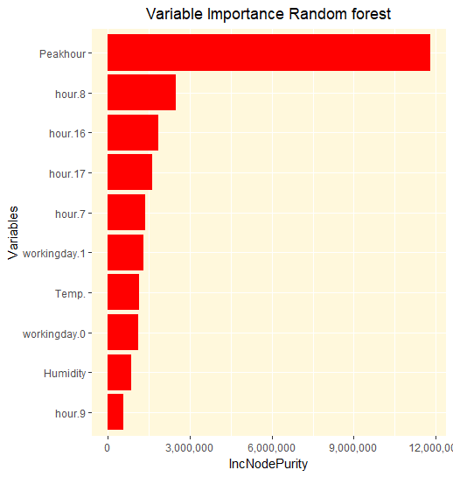
Variable Importance
Peak hour is an important feature the demand depends on, across both non linear and linear models.
Different variables are considered important from these models.

Slide 24
Work done but not covered
Used RNN with LSTM to model time series data using Tensor flow.
Weighted Random forest regression.
Time Series using ARMAX.
Available on my GitHub-
https://github.com/VarnithChordia
Currently working on HMM to solve station prediction problem.

Slide 26

Thank you

